Slide 1

Training Module W3.Css
A Responsive Web Design Framework
By CathyAnn Szymchack and Robin Phinizy

Slide 2
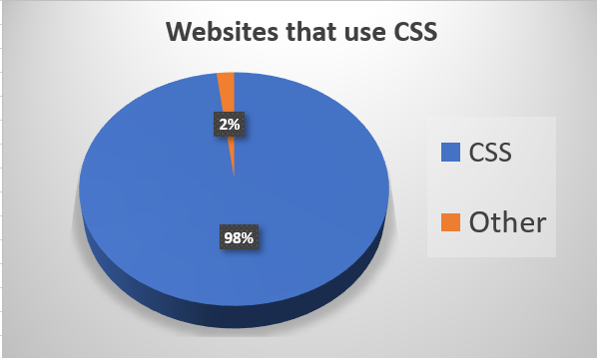
What is W3.CSS?
A framework like Bootstrap
Built in responsiveness
Ideal for modern devices

Slide 3
Who developed W3.CSS?
w3schools.com developed the framework in 2016 and it is free for anyone to use!
The framework is available to download on their website
Developers can, alternatively, link to the framework hosted on w3schools.com
It contains an extensive collection of elements, containers and grid options ready for creating beautiful websites.

Slide 4
How does it compare?
W3.CSS
Free
Bootstrap
Free
CSS
CSS & JavaScript
Lightweight
Less Popular
Advanced
Widely used

Slide 5
The LAB
Make sure everyone has downloaded the training module package
It can be found on GitHub
Follow along with the video or the live presentation

Slide 6

Objective 1
Set up an HTML file to use W3.CSS framework
Link the framework to a local copy or to the hosted copy on w3schools.com

Slide 7
Objective 2
Create W3.CSS Cards
Create a basic card
Utilize the panel class with a card
Utilize the color class with a card
Put all your cards into a container

Slide 8
Objective 3
Create W3.CSS Lists
Create a basic list within a container
Add a border and header
Use a hover class with each list item
Create an Avatar List

Slide 9
Objective 4
Utilize W3.CSS Display
Create a display container for our work
Add an image to the container
Add text to various points on the image using the display class

Slide 10
Objective Review
Set Up The Framework
Create Cards
Create Lists
Utilize Display

Slide 11
The LAB Let's Get Started

Slide 12
Learn More
www.w3schools.com

